Slide 1
Solving Differential Equations using Neural Network
Undergraduate Presentation By: Riya Singh, 21124044
Prof: Divya Goel

Slide 2
Contents:
Introduction
Neural Networks
Solving ODEs of First Order using Neural Networks
Solving ODEs of Second Order using Neural Networks
Solving PDEs using neural networks using Neural Networks
Resources

Slide 3
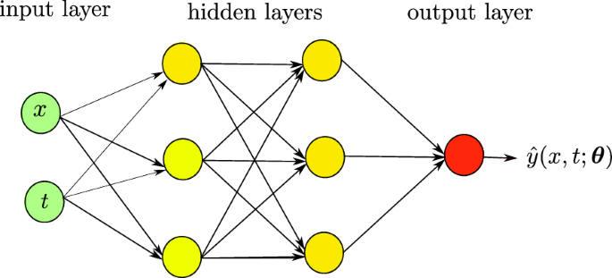
Introduction:
A neural network is a machine learning program, or model, that makes decisions in a manner similar to the human brain, by using processes that mimic the way biological neurons work together to identify phenomena, weigh options and arrive at conclusions.
Every neural network consists of layers of nodes, or artificial neurons—an input layer, one or more hidden layers, and an output layer. Each node connects to others, and has its own associated weight and threshold.
Neural networks rely on training data to learn and improve their accuracy over time. Once they are fine-tuned for accuracy.

Slide 4
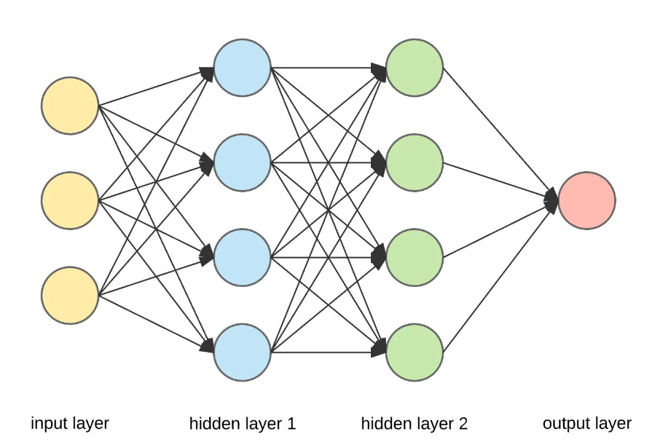
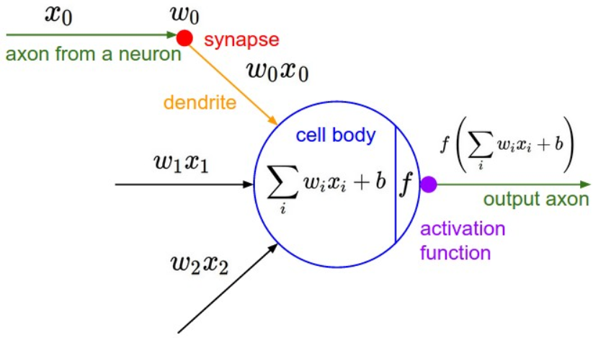
Neural Network Architecture:
Overall Structure of whole network
Process happening on each node in network

Slide 5
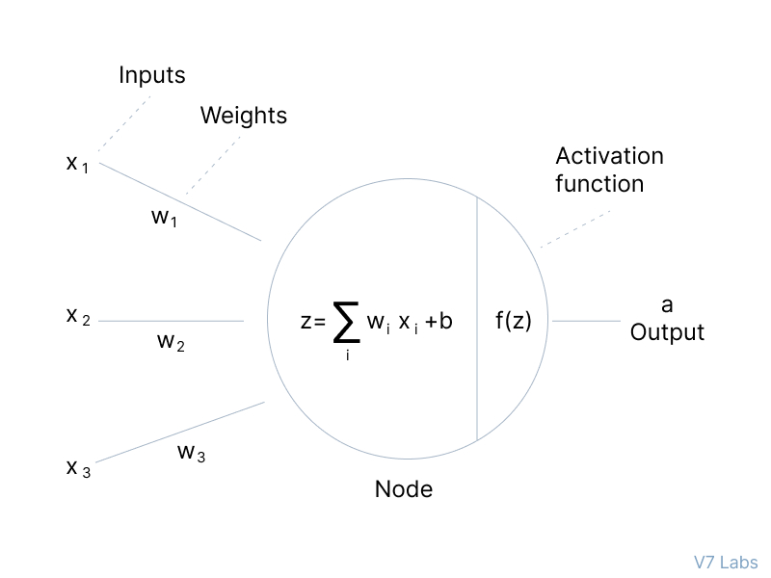
Activation functions:
The activation function decides whether a neuron should be activated or not by calculating the weighted sum and further adding bias to it. The purpose of the activation function is to introduce non-linearity into the output of a neuron.
The need for these activation functions includes converting the linear input signals and models into non-linear output signals, which aids the learning of high order polynomials for deeper networks.

Slide 6
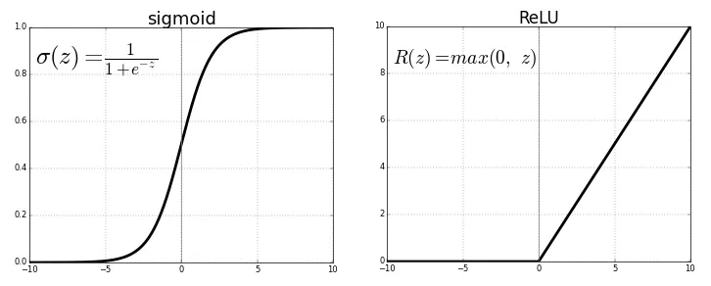
Activation Functions(Contd):
Commonly used activation functions in neural networks implementations.

Slide 7
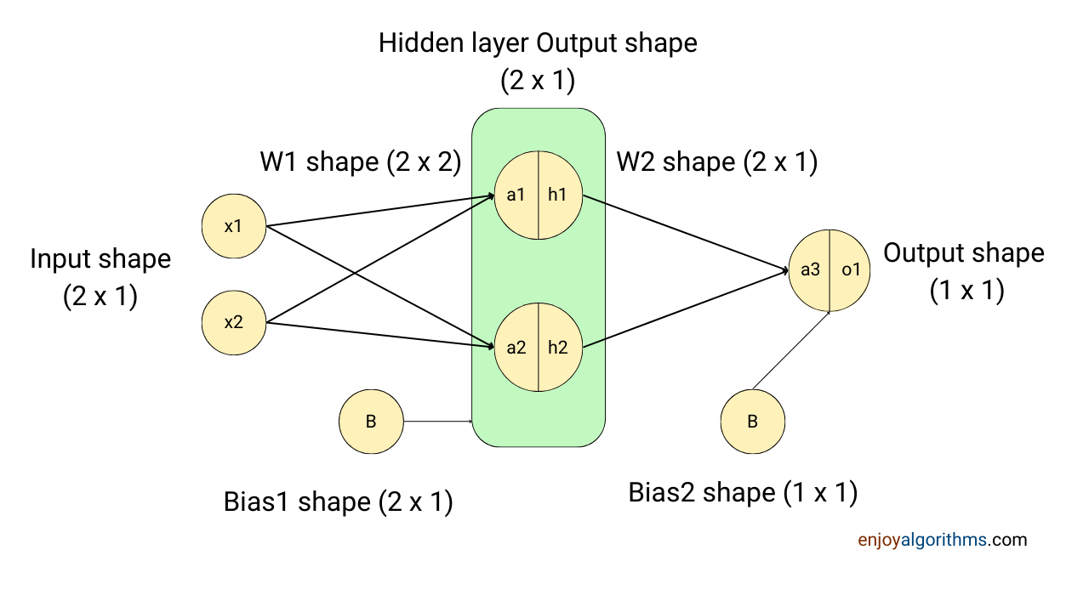
Forward Pass:
The hidden layer has two nodes which will be treated as the input for the later layer, so the second dimension of the weight matrix will also be 2, making the final dimension between the hidden and input layer as (2X2).
The resultant matrix with the multiplication of W.T. and X would be (2X1), and to make matrix addition valid, B will also have a shape of (2X1).
Similarly we know the output layer has 1 node, and the final output we expect is of (1X1) . The output of the hidden layer will have a shape of (2X1) .

Slide 8
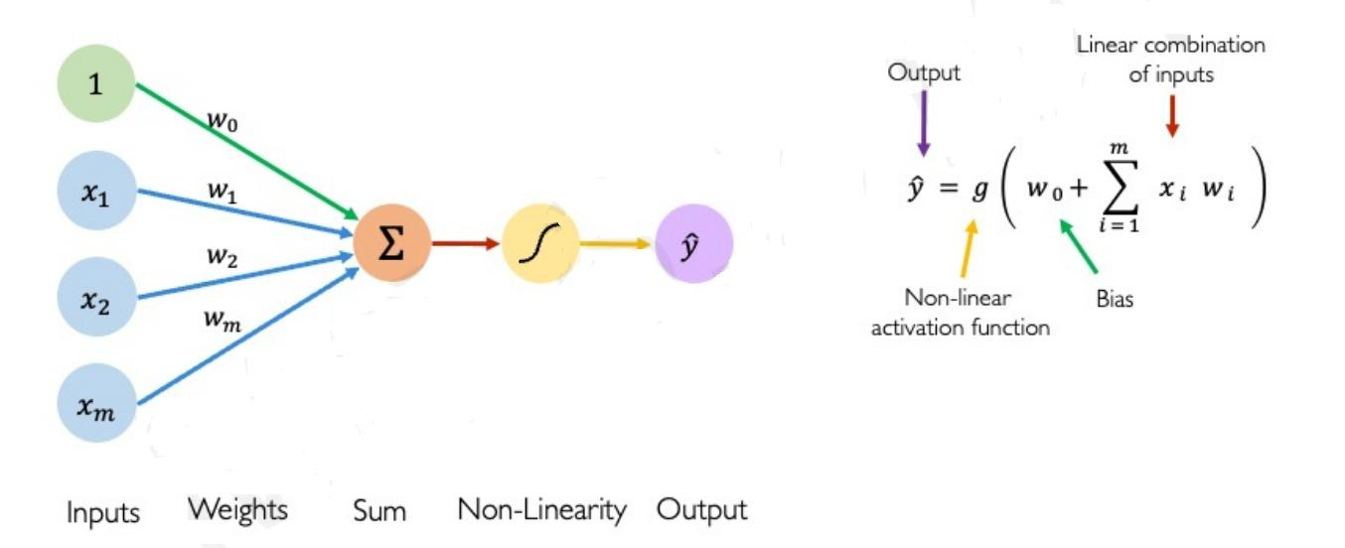
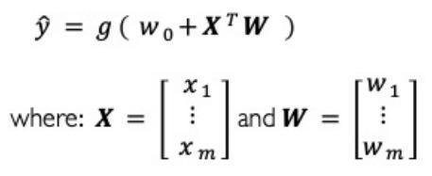
Forward Propagation:

Slide 9
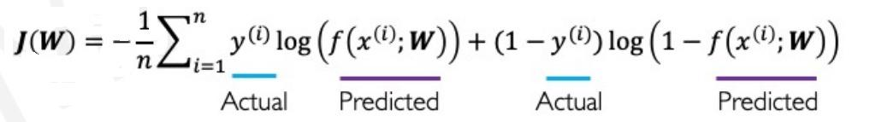
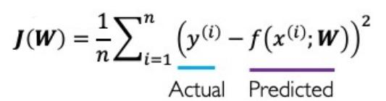
Loss Functions in neural networks:
Binary Cross Entropy Loss Function
Mean Squared Error Loss

Slide 10
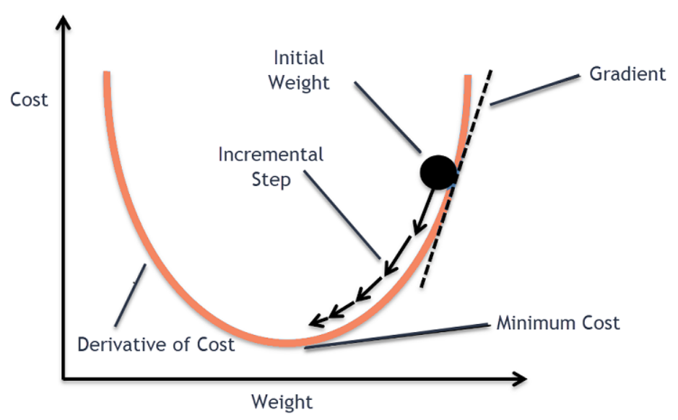
Gradient Descent:
Gradient Descent is an optimization algorithm for finding a local minimum of a differentiable function. Gradient descent in machine learning is simply used to find the values of a function’s parameters (coefficients) that minimize a cost function as far as possible.
Two crucial components of the gradient descent algorithm are the learning rate (alpha) and the derivatives terms.
The derivative terms play a crucial role in the gradient descent algorithm by providing information about the slope of the cost function with respect to each parameter.

Slide 11
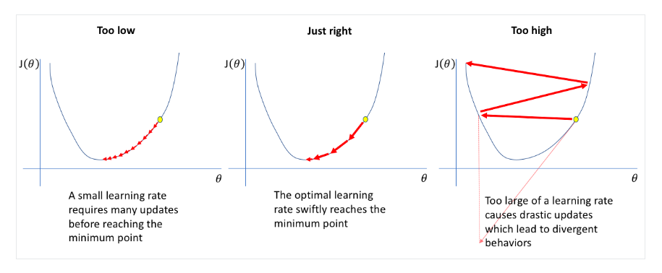
Impact of learning rate (alpha):

Slide 12
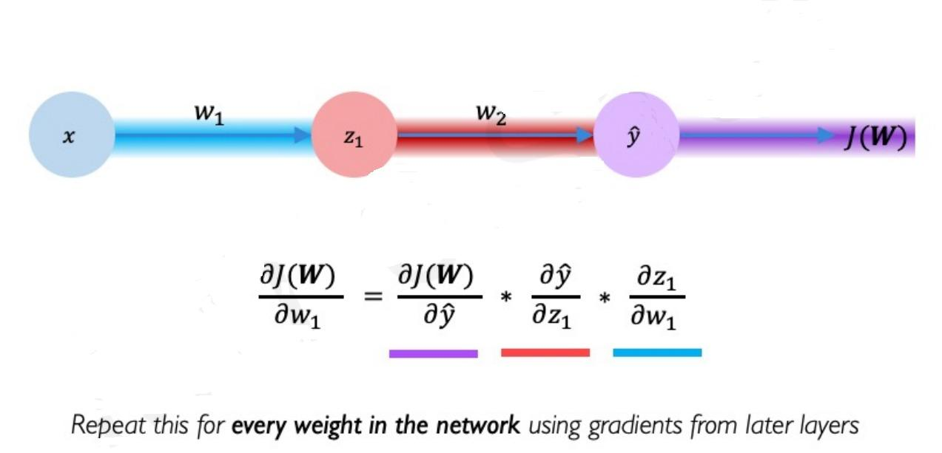
Gradient Descent (Backpropagation):

Slide 13
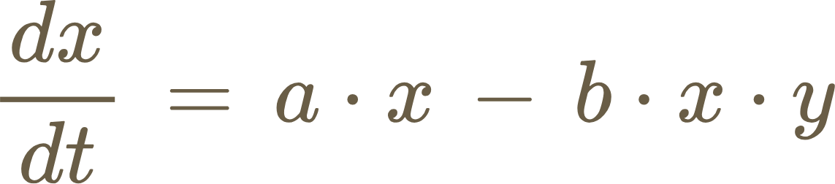
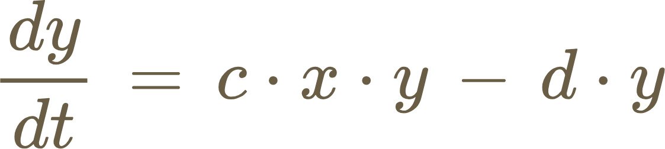
Why need neural networks in solving differential Equations ?
Consider a differential equation describing a nonlinear dynamic system, such as Lotka-Volterra equations which model the interaction between predators and prey in an ecosystem.
x represents the population of prey(e.g: rabbit)
y represents the population of population(e.g: foxes)
A,b,c,d are the parameters controlling the dynamics of the system
The Lotka Volterra equations are nonlinear and do not have a closed-form solutions for arbitrary initial conditions and parameters values.
Traditional methods like Euler’s method or Runge-Kutta methods can approximate solutions, but they struggle with accuracy or efficiency for complex systems or high-dimensional problems.

Slide 14
Solving ODEs using neural network
An ODE looks of the form:
Developing the trial solution to compute the output of ODE using neural networks:
Where N(x,P) is the output from the neural networks and h1(x) is introduced to make gt(x) satisfy the initial or boundary conditions.
An optimization method could be used on the weights and biases to optimize them through the back propagation. For Back Propagation we define a cost function:
Neural network then should find the parameters P that minimizes the cost function for a set of N training samples.

Slide 15
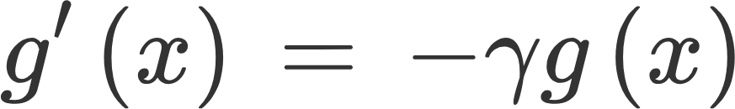
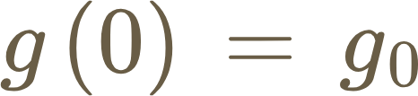

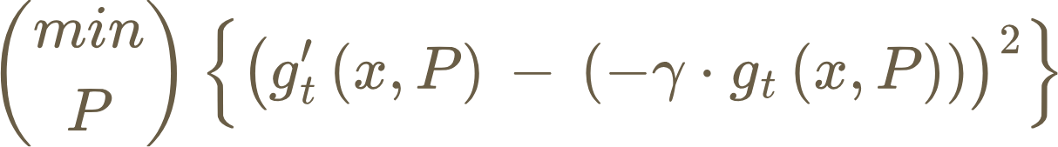
Solving ODEs using neural network(Condt):
Given the differential equation to solve:
with,
Now, we define out trial solution as:
We have to solve now,
The cost function can be defined as,

Slide 16
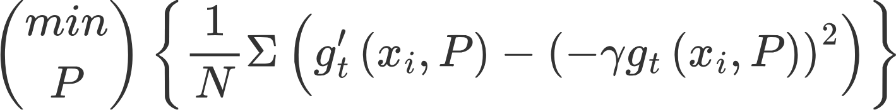
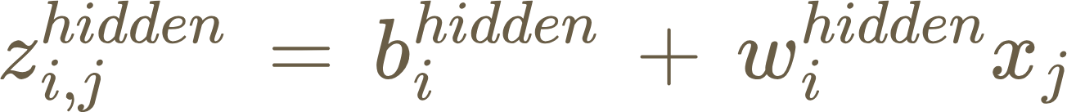
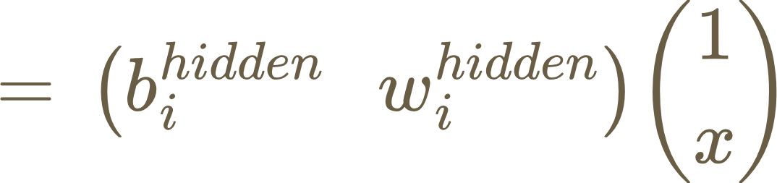
Solving ODEs using neural network(Condt):
If the neural network evaluates gt(x,P) at more values for x, say N values for i = 1,2,....N, then the total error to minimize becomes
For simplicity, it is assumed that the input is an array x =(x1,x2,....xn) with n elements. It is these points the neural network should find the P such that it fulfills the above mentioned condition.
First, the neural network must feed forward the inputs. This means that xs must be passed through an input layer, a hidden layer and an output layer. For the i th of the hidden layer with weights wi hidden and bias bi hidden the weighting from the jth neuron at the input layer is:

Slide 17
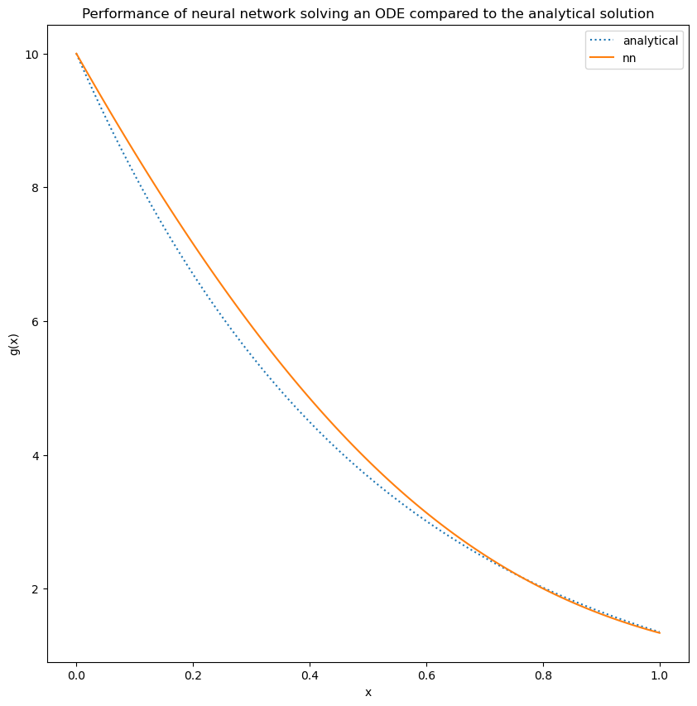
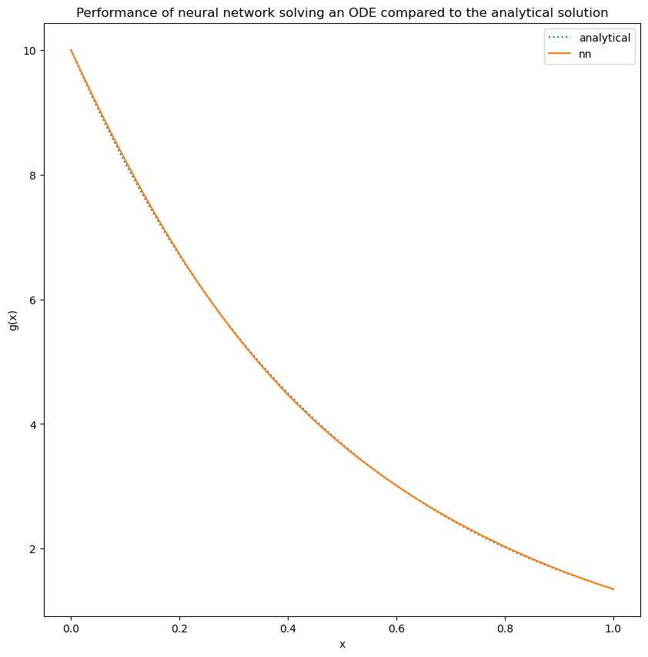
Solving ODEs using neural network (Results):
In 1000 iterations
In 10,000 iterations

Slide 18
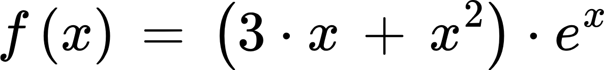
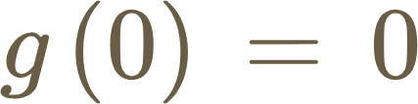
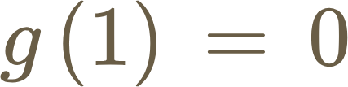
Solving ODEs using neural network (Second Order):
Now we will solve ODE of order two in a similar manner, the system to be solved is:
The initial conditions:
The trial solution for this system:
We can now compare the results for this example from both the methods, i.e. the neural network result via the trial solution and the numerical approximation method used to approximate the solution for this equation.

Slide 19
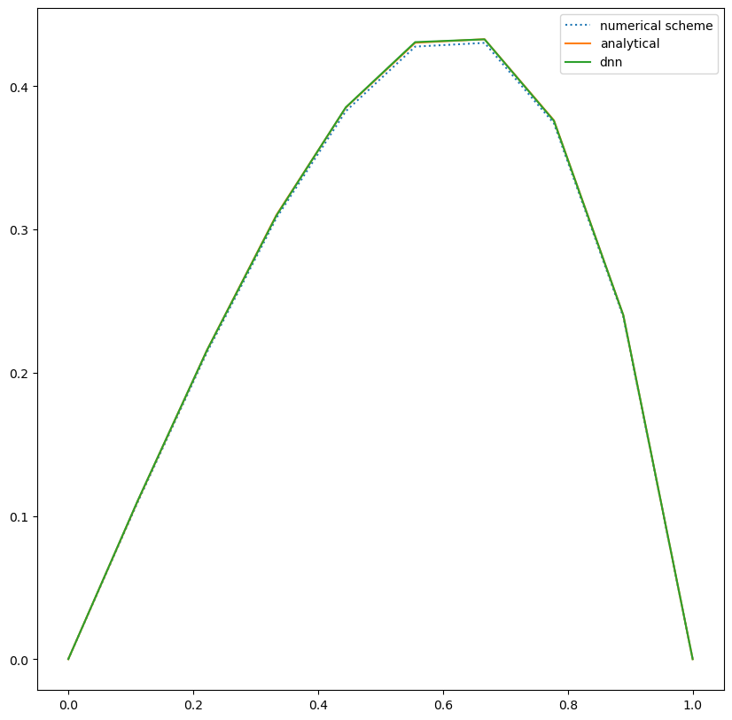
Solving ODEs using neural network (Results):
Output from program(Code):
Initial cost: 457.256
Final Cost: 0.00310113
The max absolute difference between the analytical solution and DNN Autograd : 0.000464088
The max absolute difference between the analytical solution and numerical scheme : 0.00266858

Slide 20
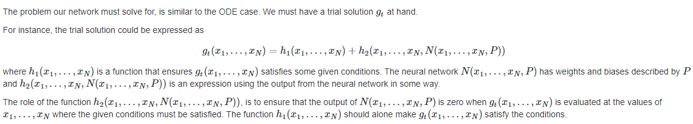
Solving PDEs using neural network
A partial differential equation of the function g(x1,...xn) is of the form:

Slide 21
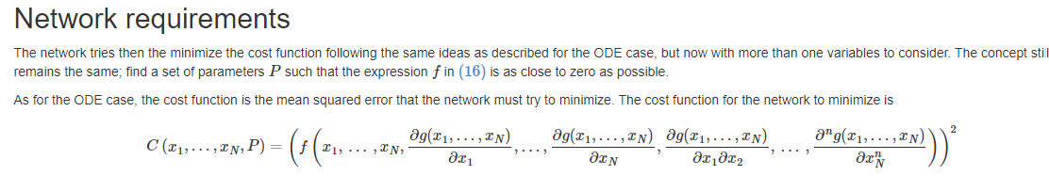
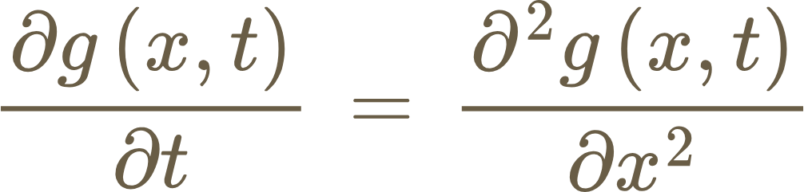
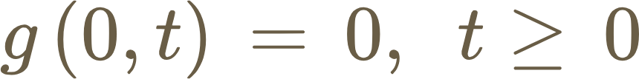
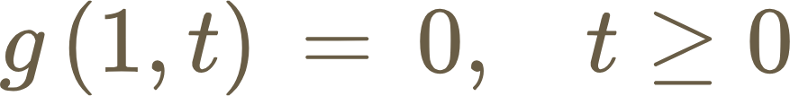
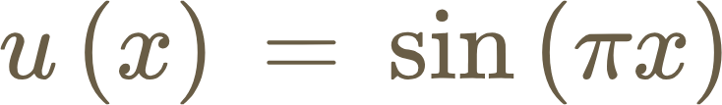
Solving PDEs using neural network(Condt):
For example: Diffusions equation
where a possible choices of conditions are:

Slide 22
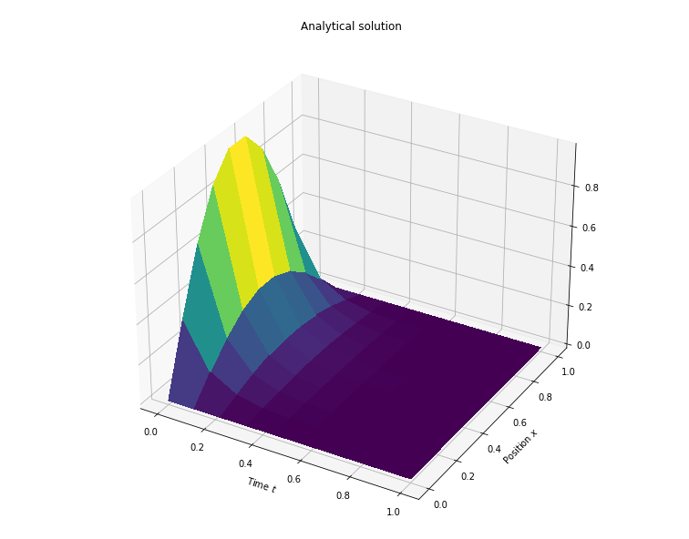
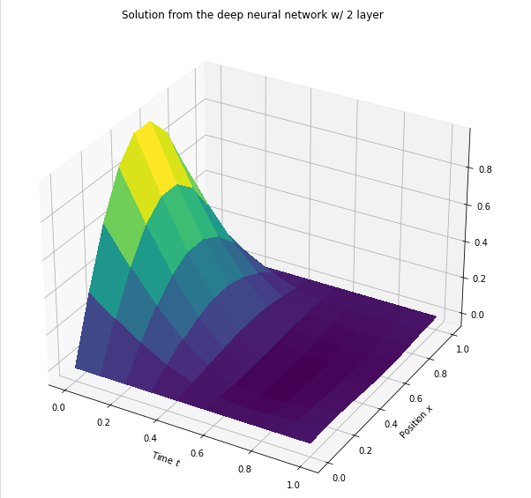
Solving PDEs using neural network(Results):

Slide 23
Resources:
https://compphysics.github.io/CompSciProgram/doc/pub/week6/html/week6-bs.html
https://medium.com/@Coursesteach/machine-learning-part-8-2e5e4c92de4b
https://www.javatpoint.com/gradient-descent-in-machine-learning
http://introtodeeplearning.com/2023/slides/6S191_MIT_DeepLearning_L1.pdf
https://www.enjoyalgorithms.com/blog/forward-propagation-in-neural-networks
https://compphysics.github.io/MachineLearning/doc/LectureNotes/_build/html/chapter11.html
https://d2l.ai/chapter_multilayer-perceptrons/backprop.html
Code: https://github.com/Riya91013/Ug-Presentation.git

